Slide 1
Bicyclist Safety in Denver County
Matt Burns

Slide 2
Introduction & Questions
3
Is Denver County and the Denver Metro Area safe for bicyclists?
What are the most dangerous roads for bicyclists and where can we improve bike safety?

Slide 3
Data & Methodology
The Datasets
Methodology
Data published by state of Colorado
Detailed information on all vehicular accidents
Time period of 2013-2023
CSV file of detailed information on each accident
Shapefile for geographic plotting
Jupyter Notebook
Software Libraries Used:
Pandas, Numpy, Matplotlib, Geopandas, Contextily, and Seaborn

Slide 4
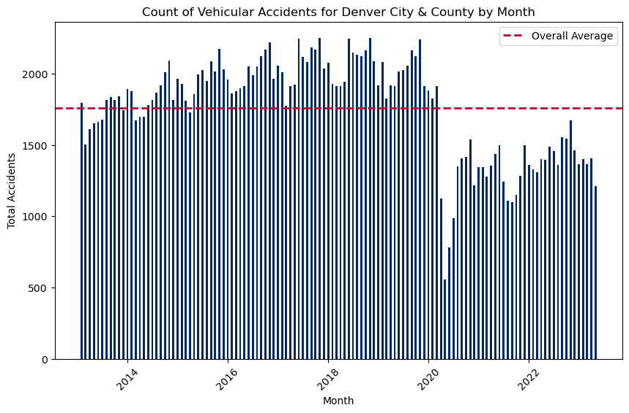
The Bigger Picture
From 2013 to early 2020, vehicular accidents were on the rise each year.
The COVID-19 pandemic in earl 2020 severely changed the number of accidents for the better.
Accidents have not returned to pre-pandemic numbers.
Logically, the white-collar jobs of downtown more easily transitioned to remote work.

Slide 5
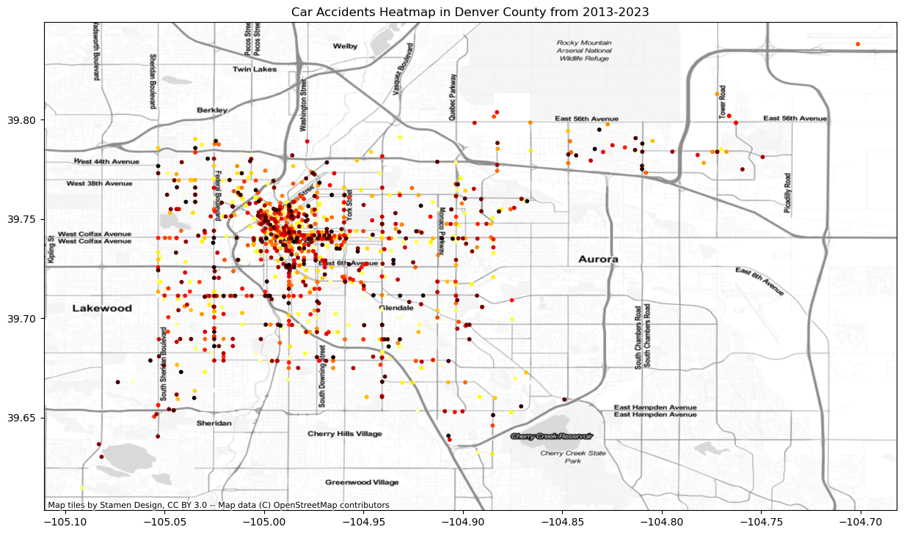
Bicycle Incidents Heatmap
This visual shows the locations with the most bicycle related vehicular accidents.
Downtown Denver is a dangerous place for everyone, bicyclists, vehicles, and pedestrians.
Natural lines of increased accidents are drawn along major roads.

Slide 6
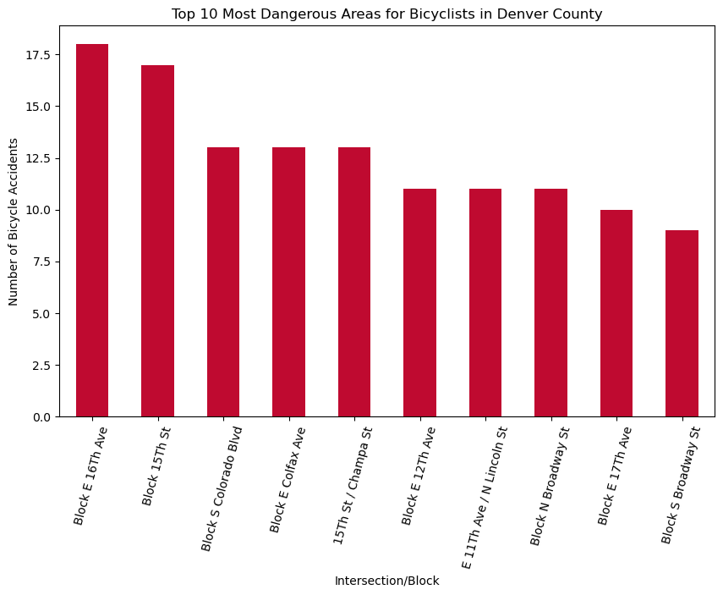
Areas Bicyclists Should Avoid
E 16th Avenue is one block north of E Colfax.
15th Street is a major road and connection to West of I-25 neighborhoods.
S Colorado Boulevard is a major intersection for vehicles and bicyclists on the Cherry Creek Trail.

Slide 7
E Colfax area and 15th street area are the most dangerous areas in Denver County for Bicyclists.

Slide 8
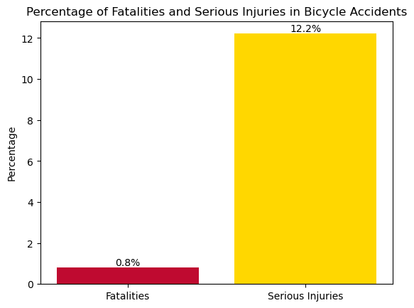
The Dangers
Does not include ongoing investigations or undisclosed injuries/fatalities.
0.8% of all bicycle related vehicular accidents end in death.
12.2% of these accidents end in serious injuries.

Slide 9
Summary
Accidents have dropped significantly from pre-pandemic times.
There are clear areas of Denver County that are the most dangerous for bicyclists.
These are points of improvement for the city/county to better keep bicyclists safe on the road.
In the meantime, bicyclists should avoid the areas listed on slide 6, especially the areas of around E Colfax and 15th Street.
​

Slide 10
Thank you
Matt Burns
Final Project
MSDS670

